Slide 1
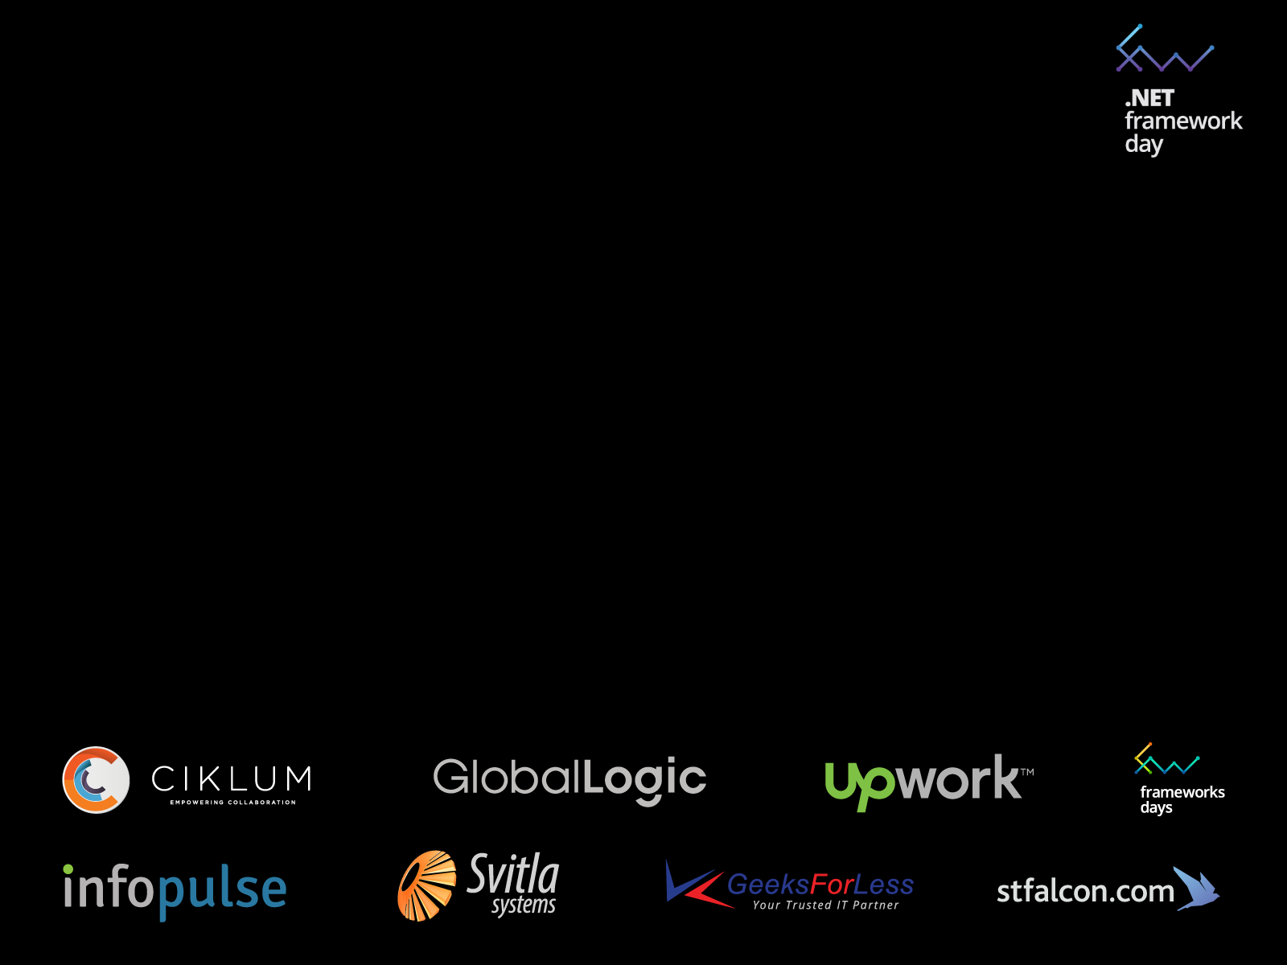


Walk in a distributed systems park
with Orleans
Yevhen Bobrov
yevhen
@
YouScan.io

Slide 2
Orleans is …
… runtime and programming model for building distributed systems based on actor model

Slide 3
Built by eXtreme Computing Group
at Microsoft Research
Has been used internally (during last few years)
Open-sourced in 2015
(available on GitHub and Nuget)

Slide 4
Scalability
Availability
built for *
Reliablity

Slide 5

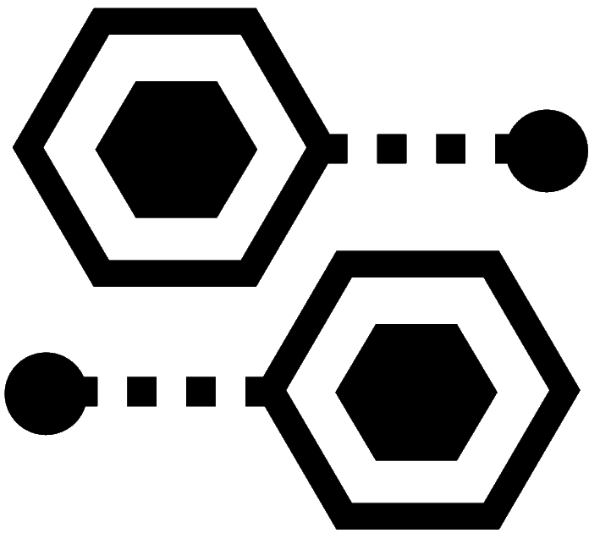
11+ million players
1.5 billion games
270 million hours
powered by
HALO4
Orleans

Slide 6
Why do we need it?

Slide 7
Stateless Services
Service

Slide 8
Stateless Services
Service

Slide 9
Stateless Services
Service
Service

Slide 10
Stateless Services
Service
Service

Slide 11
Stateless Services
Service
Service

Slide 12
Stateless Services
Service
Service
Service

Slide 13
Stateless Services
Service
Service
Service

Slide 14
Data Shipping Paradigm
Service
Service
Service

Slide 15
Data Shipping Paradigm
Service
Service
Service

Slide 16
Data Shipping Paradigm
Service
Service
Service

Slide 17
Data Shipping Paradigm
Service
Service
Service

Slide 18
Data Shipping Paradigm
Service
Service
Service

Slide 19
Data Shipping Paradigm
Service
Service
Service

Slide 20
Data Shipping Paradigm
Service
Service
Service

Slide 21
Data Shipping Paradigm
Service
Service
Service

Slide 22
Data Shipping Paradigm
Service
Service
Service

Slide 23
Data Shipping Paradigm
Service
Service
Service

Slide 24
Data Shipping Paradigm
Service
Service
Service

Slide 25
Data Shipping Paradigm
Service
Service
Service

Slide 26
Data Shipping Paradigm
Service
Service
Service

Slide 27
Data Shipping Paradigm
Service
Service
Service

Slide 28
Stateless Services (a.k.a 3-tier)
scales very badly

Slide 29
In a Cloud
latency will kill you

Slide 30
Stateful Services

Slide 31
Function Shipping Paradigm
Service
Service
Service

Slide 32
Function Shipping Paradigm
Service
Service
Service

Slide 33
Function Shipping Paradigm
Service
Service
Service

Slide 34
Function Shipping Paradigm
Service
Service
Service

Slide 35
Function Shipping Paradigm
Service
Service
Service

Slide 36
Function Shipping Paradigm
Service
Service
Service

Slide 37
Function Shipping Paradigm
Service
Service
Service

Slide 38
Function Shipping Paradigm
Service
Service
Service

Slide 39
Function Shipping Paradigm
Service
Service
Service

Slide 40
Function Shipping Paradigm
Service
Service
Service

Slide 41
Function Shipping Paradigm
Service
Service
Service

Slide 42
Stateful Services

Slide 43
Stateful Services
shared state

Slide 44
Stateful Services
shared state
concurrency, locks, and all that jazz

Slide 45
Stateful Services
PAIN
shared state
concurrency, locks, and all that jazz

Slide 46
Actor Model
Single-threaded execution (no need to use locks)
Data locality and consistency (due to encapsulation)
Objects on steroids

Slide 47
Stateful Services
Actors make it simple

Slide 48
How to distribute?

Slide 49
Akka / Erlang
var game = activate(“game”, “tcp://10.0.0.1”)
game.invoke(“foo()”)
10.0.0.1
var user = activate(“user”, “tcp://10.0.0.2”)
user.invoke(“bar()”)
10.0.0.2

Slide 50
Routing Problems
10.0.0.5
10.0.0.1
10.0.0.2
10.0.0.8

Slide 51
Routing Problems
10.0.0.5
10.0.0.1
10.0.0.2
10.0.0.8

Slide 52
Routing Problems
Cluster Membership

Slide 53
Routing Problems
Cluster Membership
Workload Distribution

Slide 54
Routing Problems
Cluster Membership
Workload Distribution
Static

Slide 55
Routing Problems
Cluster Membership
Workload Distribution
Static
Dynamic

Slide 56
Routing Problems
Cluster Membership
Workload Distribution
Static
Distributed Consensus
Dynamic

Slide 57
Routing Problems
Cluster Membership
Workload Distribution
Static
Distributed Consensus
Dynamic
Timeouts

Slide 58
Routing Problems
Cluster Membership
Workload Distribution
Static
Distributed Consensus
Dynamic
Timeouts
Lifecycle

Slide 59
Routing Problems
Cluster Membership
Workload Distribution
Static
Distributed Consensus
Dynamic
Timeouts
Lifecycle
Co-location

Slide 60
Routing Problems
Cluster Membership
Workload Distribution
Static
Distributed Consensus
Dynamic
Timeouts
Lifecycle
PAIN
Co-location

Slide 61
Orleans is …
… runtime and programming model for building distributed systems based on actor model

Slide 62
Scalability
Availability
How?
Reliablity

Slide 63
Virtual Actors

Slide 64
Location Transparency
Akka / Erlang
var game = activate(“game”, “tcp://10.0.0.1”)
game.invoke(“foo()”)
Orleans
var game = activate(“game”) “tcp://10.0.0.1”)
game.invoke(“foo()”)

Slide 65
Perpetual Existence
Akka / Erlang
var game = activate(“game”, “tcp://10.0.0.1”)
game.invoke(“foo()”)
Orleans
var game = activate(“game”, “tcp://10.0.0.1”)
game.invoke(“foo()”)

Slide 66
Runtime takes care of
Placement
Lifecycle
inversion of control

Slide 67
New actor activations
Unavailable (crashed)
node
New Activation
New node joined the cluster
courtesy of @johnazariah

Slide 68
Cooperative multitasking

Slide 69

Mechanical sympathy
Thread 1
Scheduler
(turns)
Core 1
Core 2
Core N
Thread N
Threads ~= Cores

Slide 70
Non-blocking IO
Multiplexed TCP
Promises (TPL, Task, Combinators)
Millions of actors with low OS overhead
Automatic backpressure by design
Synchronous, request-response messaging

Slide 71
Tour De Orleans

Slide 72
Major Concepts
Silo
(a.k.a. Node)
Grain
(a.k.a. Actor)
Cluster
(a.k.a. Cluster)

Slide 73
Define interface:
public interface IInventoryItemGrain : IGrain
{
Task Increment(int qty);
Task Decrement(int qty);
Task<int> Total();
}

Slide 74
Define implementation:
class InventoryItemGrain : Grain, IInventoryItemGrain
{
int total;
CloudBlockBlob blob;
public async Task Increment(int qty)
{
total++;
return blob.UploadAsync(qty.ToString());
}
public Task Decrement(int qty)
{
total--;
return blob.UploadAsync(qty.ToString());
}
public Task<int> Total() => Task.FromResult(total);
}

Slide 75
Invoke:
var item = GrainFactory
.GetGrain<IInventoryItemGrain>("iPhone");
await item.Increment(100);
await item.Decrement(100);
Console.WriteLine(await item.Total());

Slide 76
More Orleans

Slide 77
Workers [auto-scale]
Reentrancy
Placement Hints [local, even distribution]
Automatic GC
Timers/Reminders
Streams [TCP, azure queues, pub-sub]

Slide 78
When to use?

Slide 79
Scaling 3-tier architecture
(stateless stateful)

Slide 80
IoT
GPS Tracker (RFID, inventory, cars)
Counters (running total)
Sensor data

Slide 81
Data stream processing
Fraud detection
Aggregation

Slide 82

Ultra-scalable & reliable web crawling

Slide 83
END

